Slide 1

Amritsar Group
Of Colleges, Amritsar
Project
DIGITAL LIBRARY MANAGEMENT SYSTEM
Project Co-Ordinator
Group:- P19
Er. Ajay Sharma
Associate Professor Department of CSE
Vishal Kumar (2000233)
Vivek Singh (2132019)
Team Leader
Sumit Kumar Giri (2000213)

Slide 2


CONTENTS
Introduction.
Objective.
Feature & Scope.
Existing System.
Snapshots.
2
Digital Library Management System Group:-P19

Slide 3

INTRODUCTION
Library is the collection of different types of books.
It provides Books for large number of readers.
Thus we need application for managing the Library.
It help to provide information on any book present in library to the user as well as staff member.
It keeps a track of book issued, returned and added to library.
A library management system is used to maintain library records. It tracks the records of the number of books in the library, how many books are issued, or how many books have been returned or renewed or late fine charges, etc.
3
Digital Library Management System Group:-P19

Slide 4

OBJECTIVE
To record the book’s details.
To record the member’s details.
Reliable as information is stored logically than physically.
Faster search of available books and members than by hand.
It saves time for the management of library.
User Management.
Students need access to authentic information.
4
Digital Library Management System Group:-P19

Slide 5

FEATURES & SCOPE
ADD,MODIFY and DELETE the Book’s and Member’s record.
SEARCH Book’s by Id, Name, Author, Index.
Search Member’s by Id, Name.
Issues and Deposit the Book’s.
Keep records of the issued Book’s by individual member’s.
View the records of Book’s stock, member’s and issued Book’s.
Help option is provided for the user.
5
Digital Library Management System Group:-P19

Slide 6

Existing System
To check availability of the book.
Manual system.
The librarian has to perform each task automatically.
Manual system can give the information about the book issued by the students.
6
Digital Library Management System Group:-P19

Slide 7

PROJECT SNAPSHOT
7
Digital Library Management System Group:-P19

Slide 8
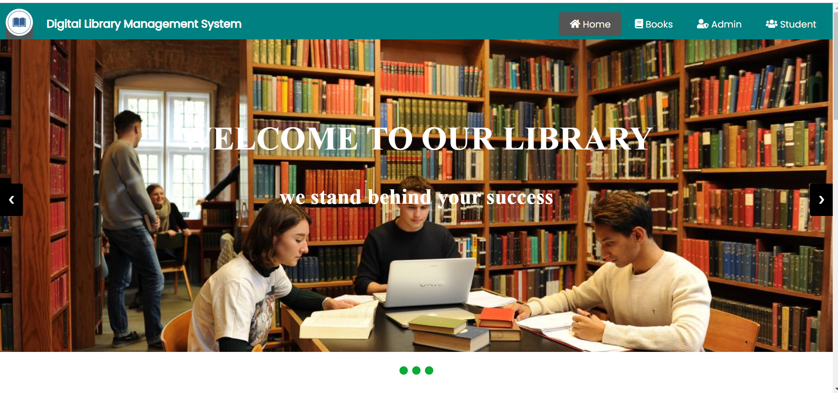
Home Page
8
Digital Library Management System Group:-P19

Slide 9
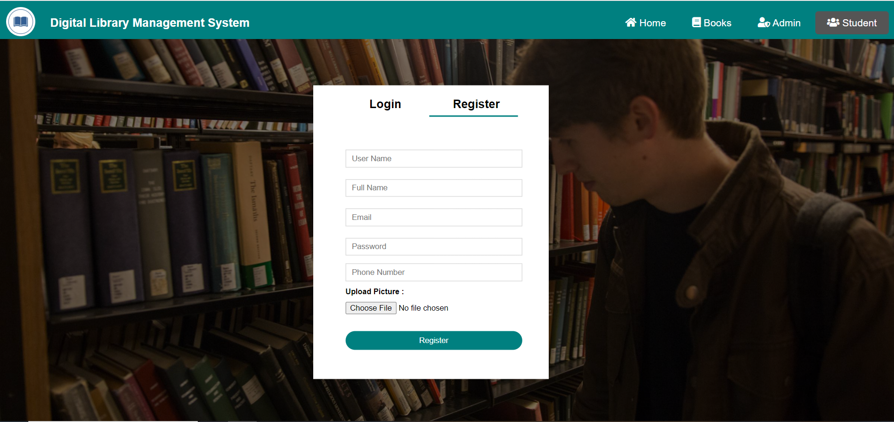
Student registration page
9
Digital Library Management System Group:-P19

Slide 10
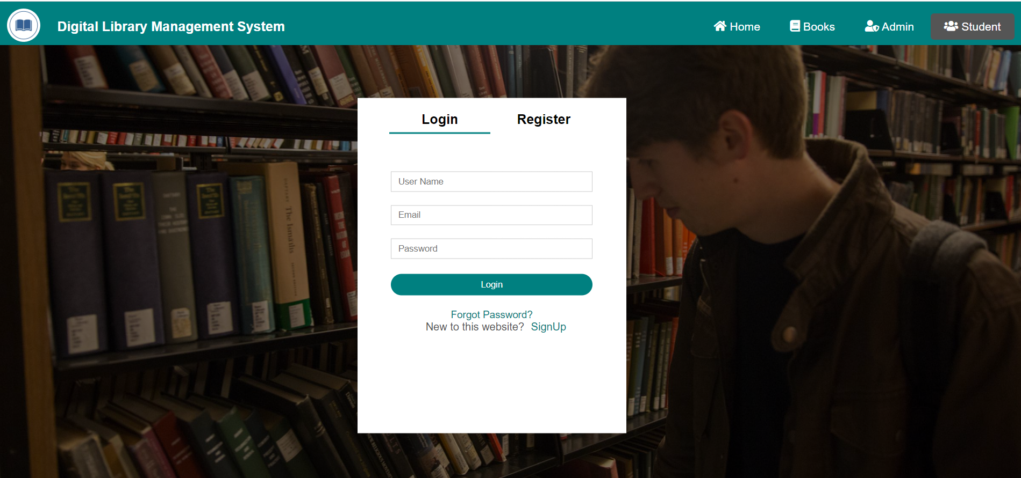
Student login page
10
Digital Library Management System Group:-P19

Slide 11

Contact page
Digital Library Management System Group:-P19
11

Slide 12
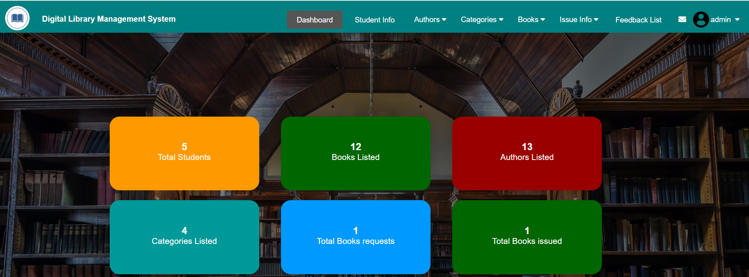

Admin page
12
Digital Library Management System Group:-P19

Slide 13
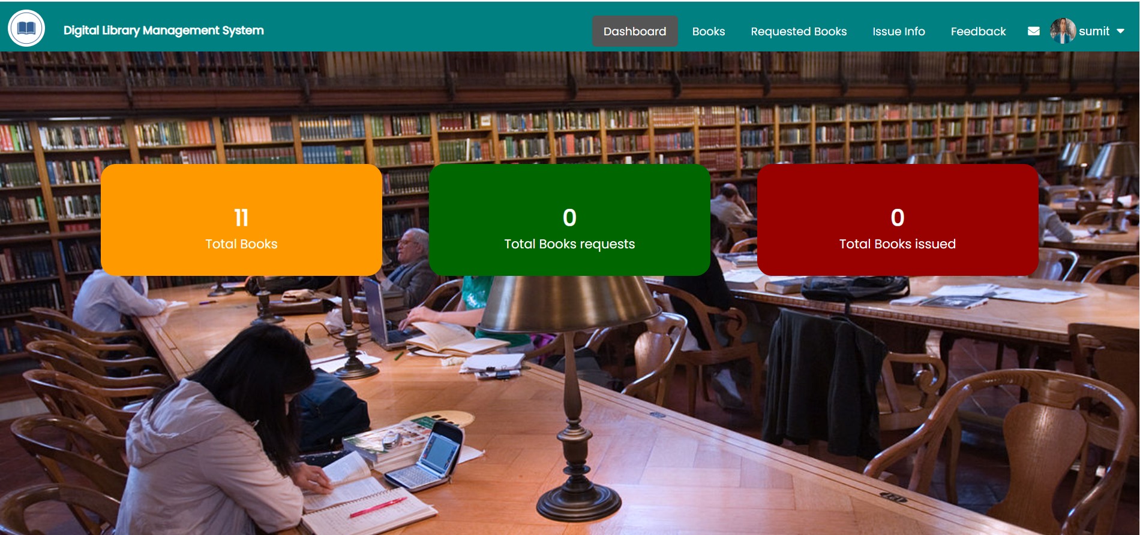
user page
13

Slide 14
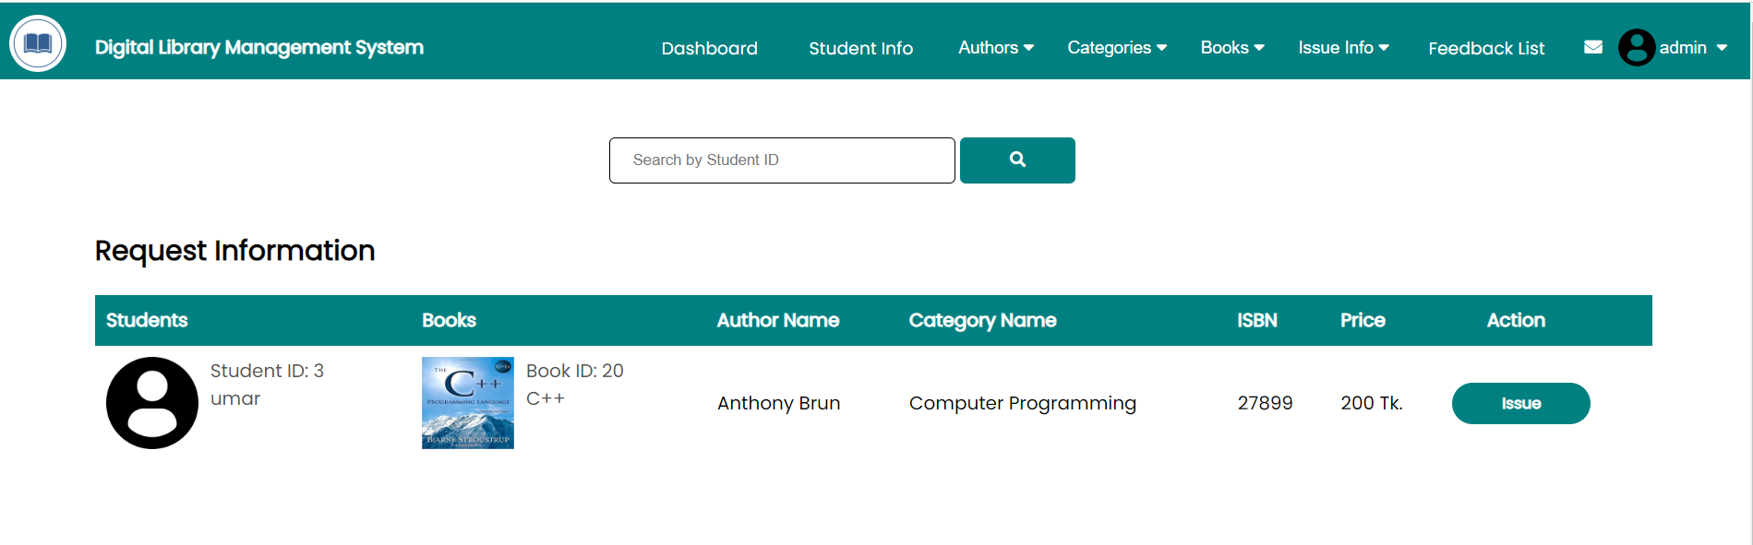
Request information page
14

Slide 15
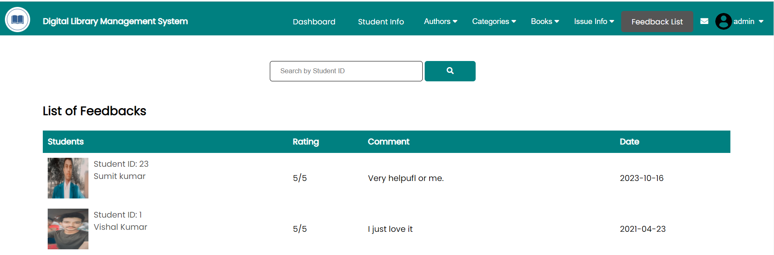
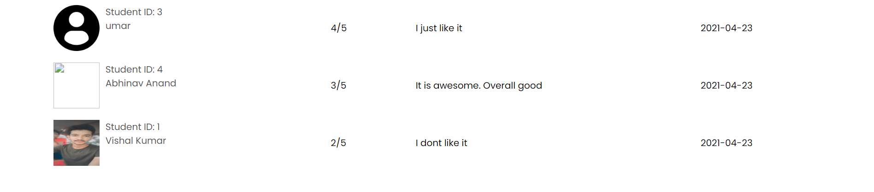
Feedback page
15

Slide 16


16

